Slide 1
Unit 2
Parallel Programming

Slide 2
Syllabus
Principles of Parallel Algorithm Design: Preliminaries, Decomposition Techniques, Characteristics of Tasks and Interactions, Mapping Techniques for Load Balancing, Methods for Containing Interaction Overheads, Parallel Algorithm Models,
Processor Architecture, Interconnect, Communication, Memory Organization, and Programming Models in high performance computing architecture examples: IBM CELL BE, Nvidia Tesla GPU, Intel Larrabee Micro architecture and Intel Nehalem micro architecture
Memory hierarchy and transaction specific memory design, Thread Organization

Slide 3
Preliminaries: Decomposition, Tasks, and Dependency Graphs
The first step in developing a parallel algorithm is to decompose the problem into tasks that can be executed concurrently
A given problem may be decomposed into tasks in many different ways.
Tasks may be of same, different, or even indeterminate sizes.
A decomposition can be illustrated in the form of a directed graph.
Such a graph is called a task-dependency graph.
Nodes correspond to tasks and edges indicate dependencies

Slide 4
Example: Multiplying a Dense Matrix with a Vector
Computation of each element of output vector y is independent of other elements. Based on this, a dense matrix-vector product can be decomposed into n tasks. The figure highlights the portion of the matrix and vector accessed by Task 1.
Observations:
Tasks share the vector b but they have no control dependencies.
There are zero edges in the task-dependency graph
All tasks are of the same size in terms of number of operations.
Is this the maximum number of tasks we could decompose this problem into?

Slide 5
Example: Database Query Processing
Consider the execution of the query:
MODEL = “CIVIC” AND YEAR = “2001” AND
(COLOR = “GREEN” OR COLOR = “WHITE”)
on the following database:
ID# | Model | Year | Color | Dealer | Price
4523 | Civic | 2002 | Blue | MN | $18,000
3476 | Corolla | 1999 | White | IL | $15,000
7623 | Camry | 2001 | Green | NY | $21,000
9834 | Prius | 2001 | Green | CA | $18,000
6734 | Civic | 2001 | White | OR | $17,000
5342 | Altima | 2001 | Green | FL | $19,000
3845 | Maxima | 2001 | Blue | NY | $22,000
8354 | Accord | 2000 | Green | VT | $18,000
4395 | Civic | 2001 | Red | CA | $17,000
7352 | Civic | 2002 | Red | WA | $18,000

Slide 6
Example: Database Query Processing
Assume the query is divided into four subtasks
Each task generates an intermediate table of entries
Edges in this graph denote dependencies.

Slide 7
Granularity of Task Decompositions
The number of tasks into which a problem is decomposed determines its granularity.
Fine granularity: Decomposition into a large number of tasks
Coarse granularity: Decomposition into a small number of tasks
A coarse grained counterpart to the dense matrix-vector product example. Each task in this example corresponds to the computation of three elements of the result vector.

Slide 8
Degree of Concurrency
The number of tasks that can be executed in parallel is the degree of concurrency of a decomposition.
Since the number of tasks that can be executed in parallel may change over program execution, the maximum degree of concurrency is the maximum number of such tasks at any point during execution.
The average degree of concurrency is the average number of tasks that can be processed in parallel over the execution of the program.
The degree of concurrency increases as the decomposition becomes finer in granularity and vice versa.

Slide 9
Critical Path, Critical Path Length
A directed path in the task dependency graph represents a sequence of tasks that must be processed one after the other.
The longest such path between any pair of zero in-degree to zero out-degree node is known as the critical path.
The length of the longest path in a task dependency graph is called the critical path length.

Slide 10
Limits on Parallel Performance
Parallel time cannot be made arbitrarily small by making the decomposition finer in granularity.
A parallel algorithm will inherently have a limited number of decomposable tasks
For example, in the case of multiplying a dense matrix with a vector, there can be no more than (n²) concurrent tasks.
Tasks interaction is another limiting factor on parallel performance
Task interaction graph: an undirected graph that captures the pattern of interactions among tasks
Note that task interaction graphs represent data dependencies, whereas task dependency graphs represent control dependencies.
The edge-set of a task-interaction graph is a superset of the edge-set of a task-dependency graph. Why?

Slide 11
Task Interaction Graphs: An Example
Consider the problem of multiplying a sparse matrix A with a vector b. The following observations can be made:
Notes
Decomposition is as before; each y[i] computation is a task.
Only non-zero elements of matrix A participate in the computation, in this case.
We also partition b across tasks; b[i] is held by Task i.

Slide 12
Processes and Mapping
In general, the number of tasks in a decomposition exceeds the number of processing elements available.
Thus, a parallel algorithm must also provide a mapping of tasks to processes.
Note: mapping is from tasks to processes, as opposed to processors.
Because typical programming APIs do not allow easy binding of tasks to physical processors.
We aggregate tasks into processes and rely on the system to map these processes to physical processors.
Processes (no in UNIX sense): logical computing agents that perform tasks
Task + task data + task code required to produce the task’s output
Processors: physical hardware units that perform tasks

Slide 13
Processes and Mapping
An appropriate mapping must minimize parallel execution time by:
Mapping independent tasks to different processes.
Assigning tasks on critical path to processes as soon as they become available.
Minimizing interaction between processes by mapping tasks with dense interactions to the same process.
These criteria often conflict with each other.
E.g., a decomposition into one task (or no decomposition at all) minimizes interaction but does not result in a speedup at all!
Can you think of other such conflicting cases?

Slide 14
Processes and Mapping: Example
Mapping tasks in the database query decomposition to processes. These mappings were arrived at by viewing the dependency graph in terms of levels (no two nodes in a level have dependencies). Tasks within a single level are then assigned to different processes.

Slide 15
Decomposition Techniques
Decomposition:
The process of dividing the computation into smaller pieces of work i.e., tasks
Tasks are programmer defined and are considered to be indivisible
So how does one decompose a task into various subtasks?
There is no single recipe that works for all problems!
Commonly used techniques that apply to broad classes of problems:
Recursive decomposition
Data decomposition
Exploratory decomposition
Speculative decomposition
Hybrid decomposition

Slide 16
Recursive Decomposition
Generally suited to problems that are solved using the divide-and-conquer strategy.
A given problem is first decomposed into a set of sub-problems.
These sub-problems are recursively decomposed further until a desired granularity is reached.

Slide 17
Example: Quicksort
Figure 3.8 The quicksort task-dependency graph based on recursive decomposition for sorting a sequence of 12 numbers.

Slide 18
Example: Finding the Minimum
1. procedure SERIAL_MIN(A,n)
2. begin
3. min =A[0];
4. for i:= 1 to n − 1 do
5. if (A[i] < min) min := A[i];
6. endfor;
7. return min;
8. end SERIAL_MIN

Slide 19
Example: Finding the Minimum
1. procedure RECURSIVE_MIN (A, n) 2. begin 3. if ( n = 1 ) then 4. min := A [0] ; 5. else 6. lmin := RECURSIVE_MIN ( A, n/2 ); 7. rmin := RECURSIVE_MIN ( &(A[n/2]), n - n/2 ); 8. if (lmin < rmin) then 9. min := lmin; 10. else 11. min := rmin; 12. endelse; 13. endelse; 14. return min; 15. end RECURSIVE_MIN

Slide 20
Example: Finding the Minimum (cont’d)
The code in the previous foil can be decomposed naturally using a recursive decomposition strategy. We illustrate this with the following example of finding the minimum number in the set {4, 9, 1, 7, 8, 11, 2, 12}. The task dependency graph associated with this computation is as follows:

Slide 21
Data Decomposition
Used to derive concurrency for problems that operate on large amounts of data
The idea is to derive the tasks by focusing on the multiplicity of data
Data decomposition is often performed in two steps
Step 1: Partition the data
Step 2: Induce a computational partitioning from the data partitioning
Which data should we partition?
Input/Output/Intermediate?
All these—leading to different data decomposition methods
How do induce a computational partitioning?
Owner-computes rule

Slide 22
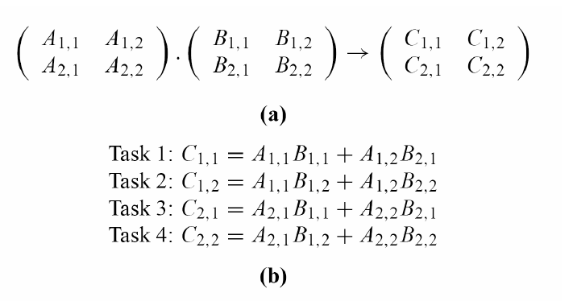
Example: Matrix-matrix Multiplication
Partitioning the output data
Applied when each element of the output data can be computed independently of the others, as a function of the input

Slide 23
Example: Database Transaction
Problem: counting the instances of given itemsets in a database of transactions.
the output (itemset frequencies) can be partitioned across tasks.

Slide 24
Output Data Decomposition: Example
From the previous example, the following observations can be made:
If the database of transactions is replicated across the processes, each task can be independently accomplished with no communication.
If the database is partitioned across processes as well (for reasons of memory utilization), each task first computes partial counts. These counts are then aggregated at the appropriate task.

Slide 25
Input Data Partitioning
Output data partitioning is applicable if each output can be naturally computed as a function of the input.
In many algorithms it is not possible or desirable to partition the output data
e.g., the problem of finding the minimum in a list, sorting a given list, etc.
In such cases, it is sometimes possible to partition the input data, and then use this partitioning to induce concurrency
A task is associated with each input data partition. The task performs as much of the computation with its part of the data. Subsequent processing combines these partial results.

Slide 26
Input Data Partitioning: Example
In the frequency counting example, the input (i.e., the transaction set) can be partitioned.
This induces a task decomposition in which each task generates partial counts for all itemsets. These are combined subsequently for aggregate counts.

Slide 27
Partitioning Input and Output Data

Slide 28
Intermediate Data Partitioning
Computation can often be viewed as a sequence of transformation from the input to the output data.
In these cases, it is often beneficial to use one of the intermediate stages as a basis for decomposition.

Slide 29
Intermediate Data Partitioning: Example
Revisiting the dense matrix multiplication example.

Slide 30
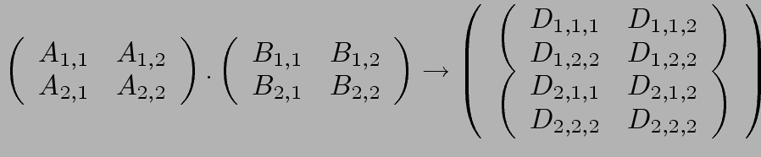
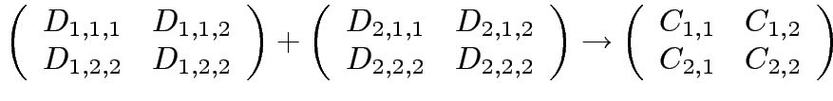
Intermediate Data Partitioning: Example
A decomposition of intermediate data structure leads to the following decomposition into 8 + 4 tasks:
Stage I
Stage II
Task 01: D_{1,1,1}= A_{1,1} B_{1,1} | Task 02: D_{2,1,1}= A_{1,2} B_{2,1}
Task 03: D_{1,1,2}= A_{1,1} B_{1,2} | Task 04: D_{2,1,2}= A_{1,2} B_{2,2}
Task 05: D_{1,2,1}= A_{2,1} B_{1,1} | Task 06: D_{2,2,1}= A_{2,2} B_{2,1}
Task 07: D_{1,2,2}= A_{2,1} B_{1,2} | Task 08: D_{2,2,2}= A_{2,2} B_{2,2}
Task 09: C_{1,1} = D_{1,1,1} + D_{2,1,1} | Task 10: C_{1,2} = D_{1,1,2} + D_{2,1,2}
Task 11: C_{2,1} = D_{1,2,1} + D_{2,2,1} | Task 12: C_{2,,2} = D_{1,2,2} + D_{2,2,2}

Slide 31
Intermediate Data Partitioning: Example
The task dependency graph for the decomposition (shown in previous foil) into 12 tasks is as follows:

Slide 32
Data Decomposition
Is the most widely-used decomposition technique
After all parallel processing is often applied to problems that have a lot of data
Splitting the work based on this data is the natural way to extract high-degree of concurrency
It is used alone or in conjunction with other decomposition methods
Hybrid decomposition

Slide 33
The Owner Computes Rule
The Owner Computes Rule generally states that the process assigned a particular data item is responsible for all computation associated with it.
In the case of input data decomposition, the owner computes rule implies that all computations that use the input data are performed by the process.
In the case of output data decomposition, the owner computes rule implies that the output is computed by the process to which the output data is assigned.

Slide 34
Exploratory Decomposition
Used to decompose computations that correspond to a search of a space of solutions
Examples theorem proving, game playing, etc.
Example: solution of the 15-puzzle problem
We show a sequence of three moves that transform a given initial state (a) to desired final state (d).

Slide 35
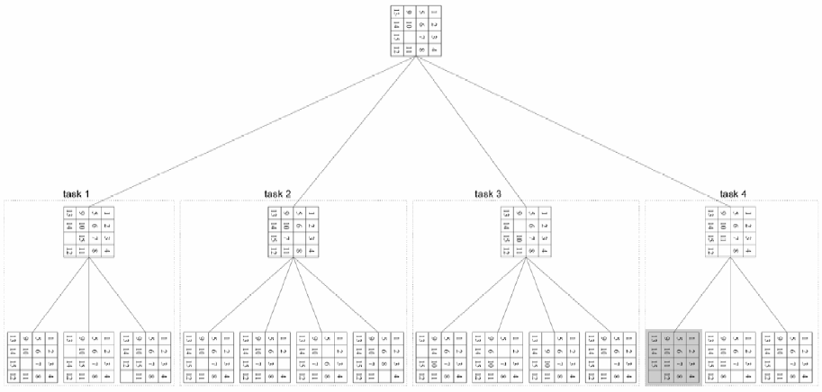
Exploratory Decomposition: Example
The state space can be explored by generating various successor states of the current state and to view them as independent tasks.

Slide 36
Exploratory Decomposition: Anomalous Computations
In many instances of exploratory decomposition, the decomposition technique may change the amount of work done by the parallel formulation.
This change results in super- or sub-linear speedups.

Slide 37
Speculative Decomposition
Used to extract concurrency in problems in which the next step is one of many possible actions that can only be determined when the current tasks finishes
This decomposition assumes a certain outcome of the currently executed task and executes some of the next steps
Just like speculative execution at the microprocessor level
Performs more or the same aggregate work (but not less) than the sequential algorithm

Slide 38
Example: Discrete Event Simulation

Slide 39
Speculative Execution
If predictions are wrong…
Work is wasted
work may need to be undone
state-restoring overhead
memory/computations
However, it may be the only way to extract concurrency!

Slide 40
Characteristics of Tasks Affecting Good Mapping
Characteristics of tasks influencing suitability of a mapping scheme
Are the tasks available a priori?
Static vs dynamic task generation
How about their computational requirements?
Are they uniform or non-uniform?
Do we know them a priori?
How much data is associated with each task?
Characteristics of inter-task interactions
Are they static or dynamic?
Are they regular or irregular?
Are they read-only or read-write?

Slide 41
Example: Regular Static Task Interaction Pattern (Simple)
An example: Image dithering application
dithering - the process of representing intermediate colors by patterns of tiny colored dots that simulate the desired color

Slide 42
Example: Irregular Static Task Interaction Pattern (Complex)

Slide 43
Mapping Techniques
Mapping: assigning tasks to processes with the objective that all tasks should complete in the shortest amount of elapsed time
Thus, a mapping scheme must address the major sources of overhead
Load imbalance
Inter-process communication
Synchronization/data-sharing
Minimizing these overheads often represents contradicting objectives.
E.g., assign all interdependent tasks to the same process
Note: Assigning a balanced aggregate load to each process is a necessary but not sufficient condition for reducing idling.

Slide 44
Mapping Techniques for Minimum Idling
Merely balancing load does not minimize idling:

Slide 45
Mapping Techniques for Minimum Idling
Static Mapping: Tasks are mapped to processes a priori (ahead of executing algorithm).
Applicable for tasks that are
generated statically
known and/or have uniform computational requirements
Dynamic Mapping: Tasks are mapped to processes at runtime.
Applicable for tasks that are
generated dynamically
unknown and/or have non-uniform computational requirements

Slide 46
Static Mapping – Array Distribution Schemes
Suitable for algorithms that
use data decomposition
their underlying input/output/intermediate data are in the form of arrays
Block Distribution
Used to load-balance a variety of parallel computations that operate on multi-dimensional arrays
Cyclic Distribution
Block-Cyclic Distribution
Randomized Block Distributions

Slide 47
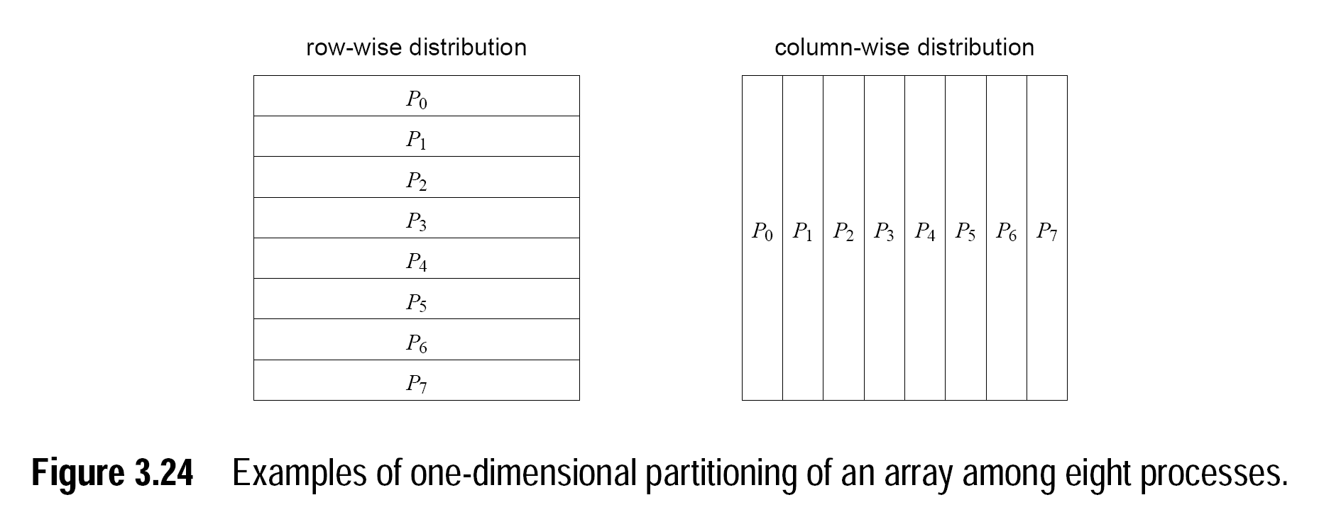
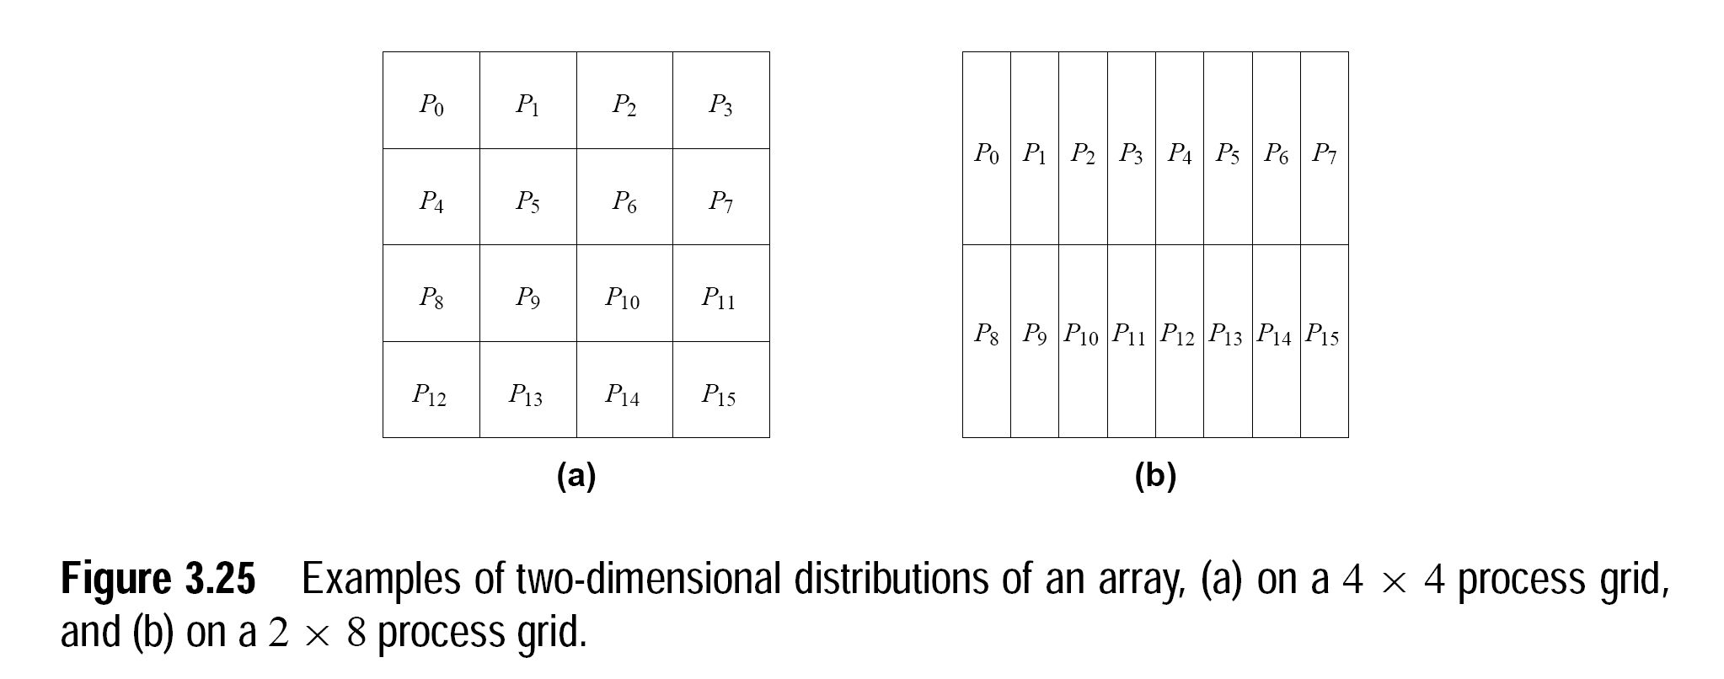
Examples: Block Distributions

Slide 48
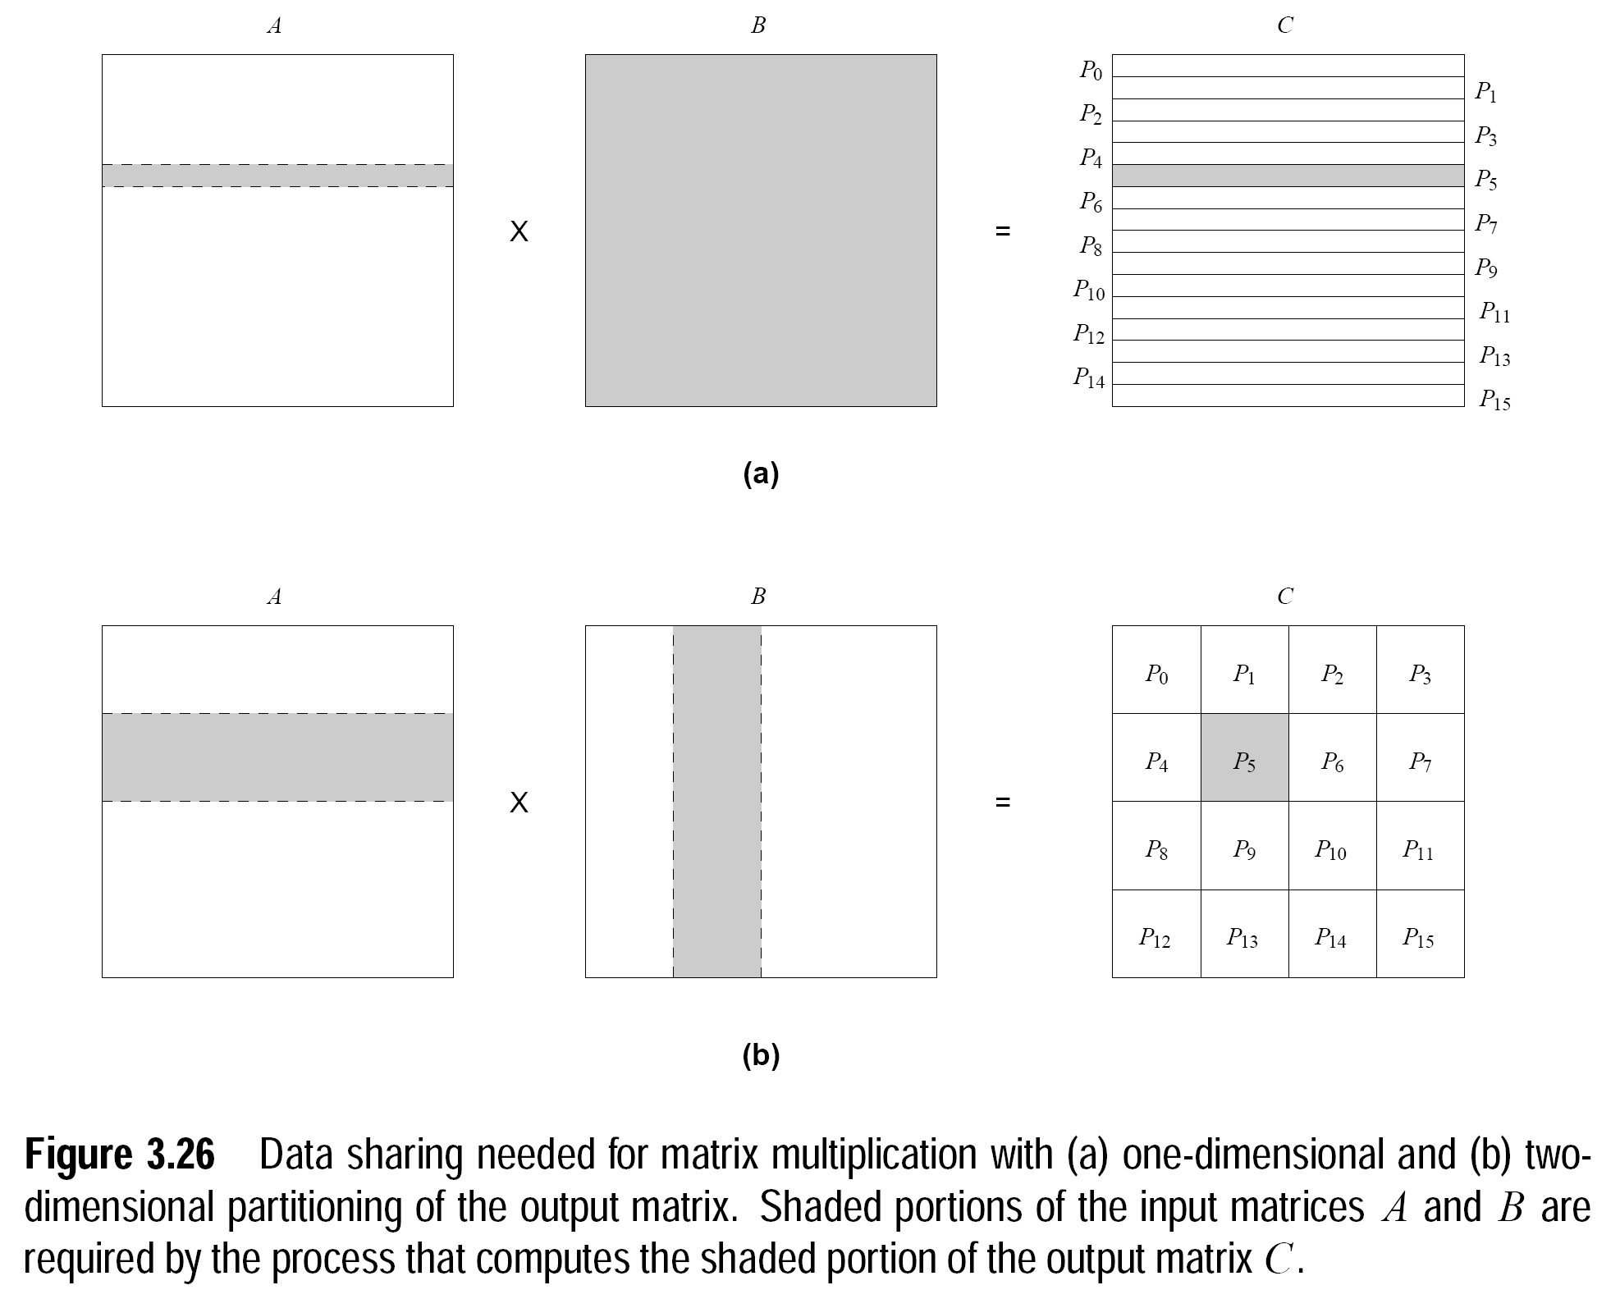
Examples: Block Distributions

Slide 49
1-Dimensional vs k-Dimensional Distributions
Which distribution allows the use of more processes?
One-dimensional?
Multi-dimensions?
Which distribution reduces the amount of interaction among processes?
One-dimensional?
How many data elements are accessed in part (a) on the previous slide?
Multi-dimensions?
How many data elements are accessed in part (b) on the previous slide?

Slide 50
Cyclic and Block Cyclic Distributions
If the amount of computation associated with data items varies, a block decomposition may lead to significant load imbalances.
A simple example of this is in LU decomposition (or Gaussian Elimination) of dense matrices.
Block cyclic distribution schemes can be used to alleviate the load-imbalance and idling problems.
Block cyclic distributions:
Partition an array into many more blocks than the number of available processes.
Blocks are assigned to processes in a round-robin manner so that each process gets several non-adjacent blocks.

Slide 51
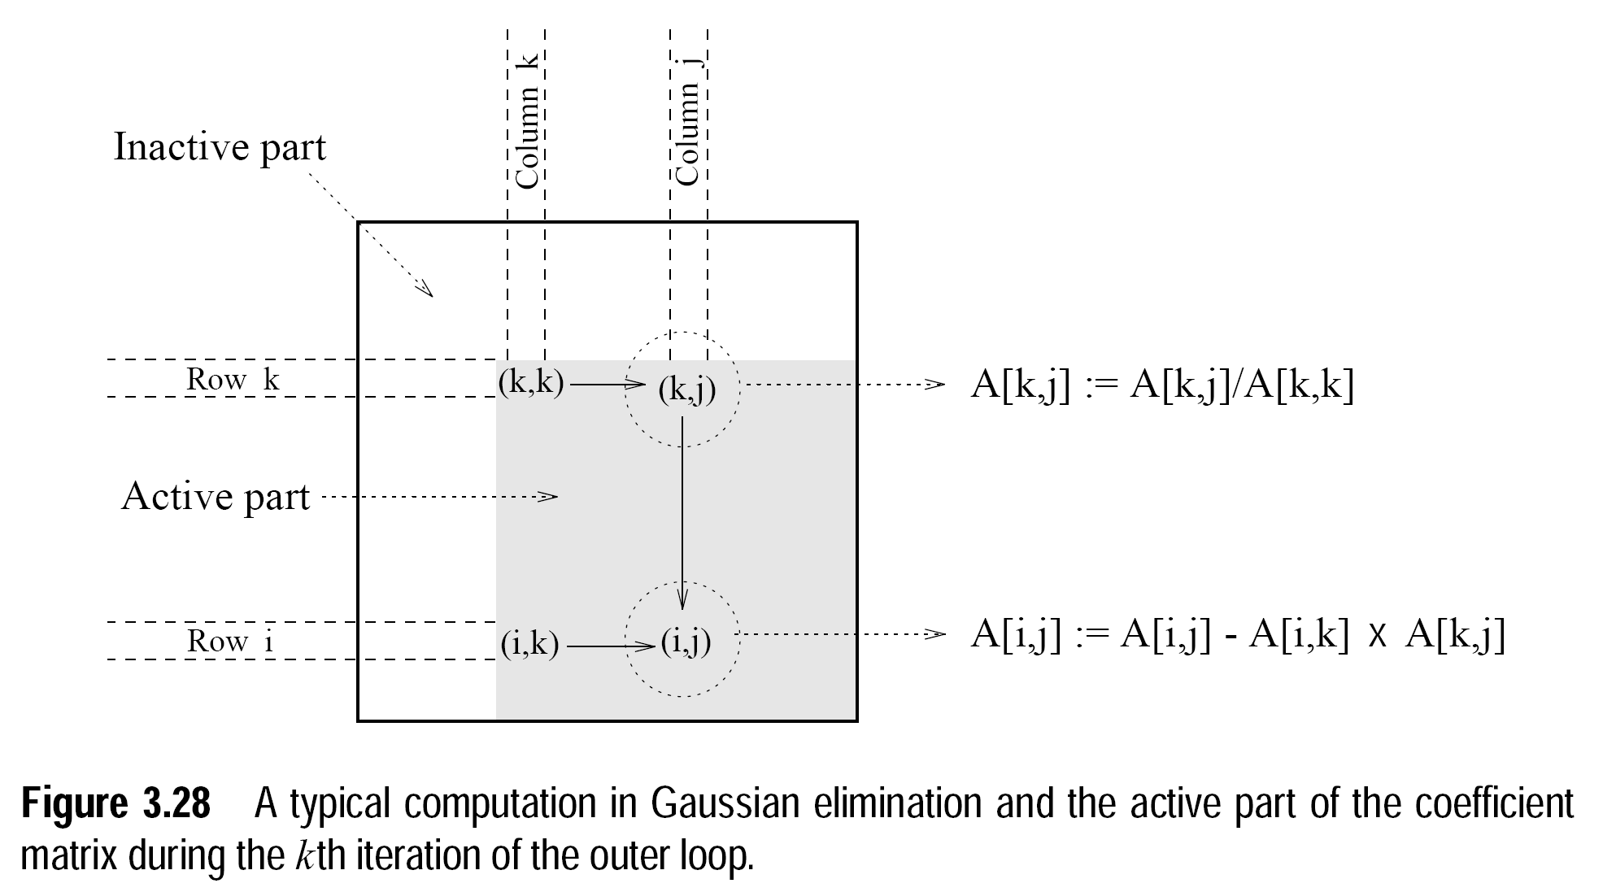
LU Factorization of a Dense Matrix

Slide 52
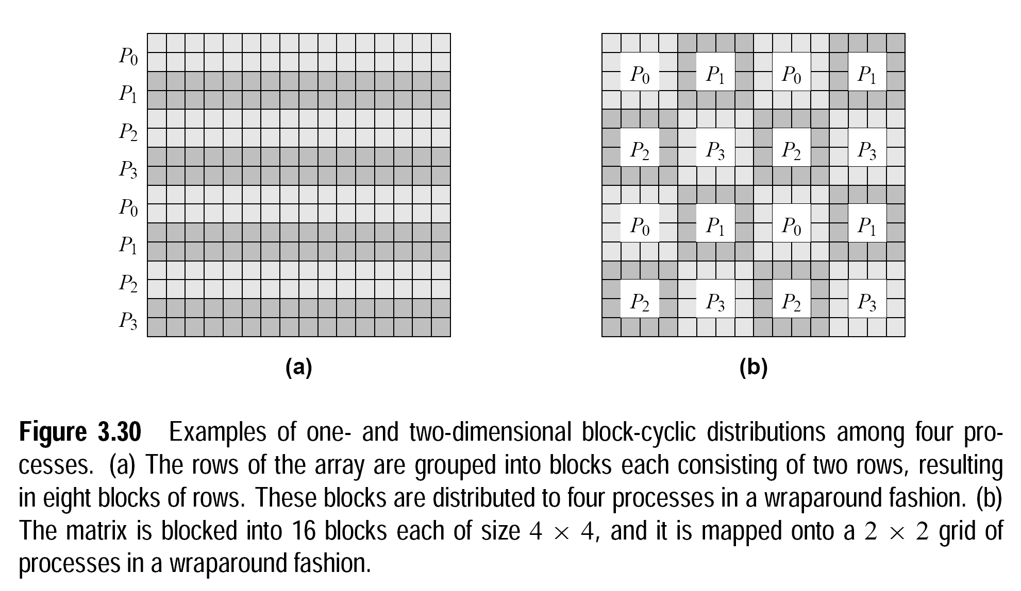
Example: Block-Cyclic Distributions

Slide 53
Mappings Based on Task Partitioning
Partitioning a given task-dependency graph across processes.
Determining an optimal mapping for a general task-dependency graph is an NP-complete problem.
Excellent heuristics exist for structured graphs.

Slide 54
Task Partitioning: Mapping a Binary Tree Dependency Graph
Consider a task-dependency graph that is a perfect binary tree
Occurs in practical problems with recursive decomposition

Slide 55
Hierarchical Mappings
Sometimes a single mapping technique is inadequate.
For example, the task mapping of the binary tree (quicksort) cannot use a large number of processes.
For this reason, task mapping can be used at the top level and data partitioning within each level.

Slide 56
Hierarchical Mappings
An example of task partitioning at top level with data partitioning at the lower level.

Slide 57
Schemes for Dynamic Mapping
Dynamic mapping is sometimes also referred to as dynamic load balancing, since load balancing is the primary motivation for dynamic mapping.
Dynamic mapping schemes can be centralized or distributed.

Slide 58
Centralized Dynamic Mapping
Processes are designated as masters or slaves.
When a process runs out of work, it requests the master for more work.
When the number of processes increases, the master may become the bottleneck.
To alleviate this, a process may pick up a number of tasks (a chunk) at one time. This is called Chunk scheduling.
Selecting large chunk sizes may lead to significant load imbalances as well.
A number of schemes have been used to gradually decrease chunk size as the computation progresses.

Slide 59
Distributed Dynamic Mapping
Each process can send or receive work from other processes.
This alleviates the bottleneck in centralized schemes.
There are four critical questions:
How are sending and receiving processes paired together,
Who initiates work transfer,
How much work is transferred, and
When is a transfer triggered?

Slide 60
Methods for Containing Interaction Overheads
Maximize data locality: Where possible, reuse intermediate data. Restructure computation so that data can be reused in smaller time windows.
Minimize volume of data exchange: There is a cost associated with each word that is communicated. For this reason, we must minimize the volume of data communicated.
Minimize frequency of interactions: There is a startup cost associated with each interaction. Therefore, try to merge multiple interactions to one, where possible.
Minimize contention and hot-spots: Use decentralized techniques, replicate data where necessary.

Slide 61
Methods for Containing Interaction Overheads
Overlapping computations with interactions: Use non-blocking communications, multithreading, and prefetching to hide latencies.
Replicating data or computations.
Using group communications instead of point-to-point primitives.
Overlap interactions with other interactions.

Slide 62
Parallel Algorithm Models
An algorithm model is a way of structuring a parallel algorithm by selecting a decomposition and mapping technique and applying the appropriate strategy to minimize interactions.
Data Parallel Model: Tasks are statically (or semi-statically) mapped to processes and each task performs similar operations on different data.
Usually based on data decomposition followed by static mapping
Uniform partitioning of data followed by static mapping guarantees load balance
Example algorithm: dense matrix multiplication
Task Graph Model: Starting from a task dependency graph, the interrelationships among the tasks are utilized to promote locality or to reduce interaction costs.
Typically used to solve problems where amount of data associated with a task is large relative to computation
Static mapping usually used to optimize data movement costs
Example algorithm: parallel quicksort, sparse matrix factorization

Slide 63
Parallel Algorithm Models
Master-Slave Model: One or more processes generate work and allocate it to worker processes. This allocation may be static or dynamic.
Pipeline / Producer-Consumer Model: A stream of data is passed through a succession of processes, each of which perform some task on it.
Hybrid Models: A hybrid model may be composed either of multiple models applied hierarchically or multiple models applied sequentially to different phases of a parallel algorithm.
The work Pool Model:

Slide 64
Parallel Algorithm Models
Work Pool Model: The work pool or the task pool model is characterized by a dynamic mapping of tasks onto processes for load balancing in which any task may potentially be performed by any process. There is no desired premapping of tasks onto processes. The mapping may be centralized or decentralized. Pointers to the tasks may be stored in a physically shared list, priority queue, hash table, or tree, or they could be stored in a physically distributed data structure. The work may be statically available in the beginning, or could be dynamically generated; i.e., the processes may generate work and add it to the global (possibly distributed) work pool. If the work is generated dynamically and a decentralized mapping is used, then a termination detection algorithm would be required so that all processes can actually detect the completion of the entire program (i.e., exhaustion of all potential tasks) and stop looking for more work.
Example : Parallelization of Loops by chunk scheduling

Slide 65
IBM BE- Cell Processor

Slide 66
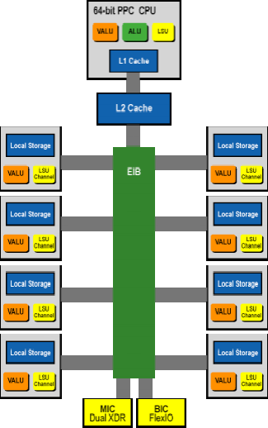
Cell Architecture: “System on a Chip”
Heterogeneous chip multiprocessor
64-bit Power Architecture with cooperative offload processors, with direct memory access and communication synchronization methods
64-bit Power Processing Element Control Core (PPE)
8 Synergistic Processing Elements (SPE)
Single instruction, multiple-data architecture, supported by both the vector media extensions on the PPE and the instruction set of the SPE's (i.e. gaming/media and scientific applications)
High-bandwidth on-chip element interconnection bus (EIB),
PPE
Main control unit for the entire Cell
32KB L1 instruction and data caches
512KB L2 unified cache
Dual threaded, static dual issue
Composed of three main units
Instruction Unit (IU)
Fetch, Decode, Branch, Issue, and Completion
Fixed-Point Execution Unit
Fixed-Point instructions and load/store instructions
Vector Scalar Unit
Vector and floating point instructions

Slide 67
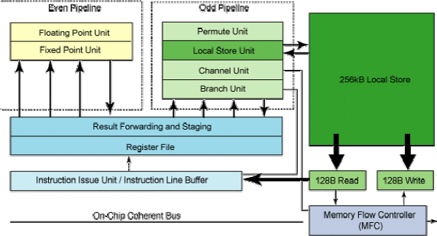
Cell Architecture: Synergistic Processing Element
Synergistic Processing Element (SPE)
SIMD instruction set architecture, optimized for power and performance of computational-intensive applications
Local store memory for instructions and data
● Additional level of memory hierarchy
● Largest component of SPE
● Single-port SRAM, capable of reading and writing through both narrow 128-bit and wide 128-byte ports
Data and instructions transferred between local store and system memory by asynchronous DMA commands, controlled by memory flow controlled on SPE
● Support for 16 simultaneous DMA commands
Programmable DMA options
● SPE instructions insert DMA commands into queues
● Pool DMA commands into a single “DMA list” command
● Insert commands in DMA queue from other SPE processors
128 entry unified register file for improved memory bandwidth, and optimum power efficiency and performance
Dynamically configurable to provide support for content protection and privacy

Slide 69
Cell Synergistic Memory Flow Controller
Provides integration between communicating SPE's within the system architecture
Utilizes the Power protection model and address translation, incorporating the SPE's into the system protection and address translation requirement
Allows data transfer and synchronization capabilities to interface with the system Element Interconnect Bus (EIB)
Supports the communication interface between the PPE and SPE elements, serving as a high performance data transfer engine between local store memories and Cell system memory
Supports the communication interface between the PPE and SPE elements, serving as a high performance data transfer engine between local store memories and Cell system memory
Parallel data transfer and processing are capable due to the offloading of data transfers from compute elements onto dedicated data transfer engines
Asynchronous high performance data transfer along with parallel data processing on the PPE and SPE's eliminate the need to explicitly interleave data processing and transfer at program level.

Slide 70
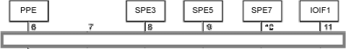
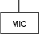
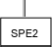
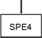
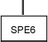
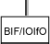
Cell Architecture: Element Interconnect Bus (EIB)
Element Interconnect Bus (EIB)
High-bandwidth on-chip element interconnection bus (EIB), allowing on-chip interactions between processor elements.
Coherant bus allowing single address space to be shared by the PPE and SPE's for efficient communication and ease of programming
Peak bandwidth of 205.8GB/s
● 4 x 16B wide channels

Slide 71
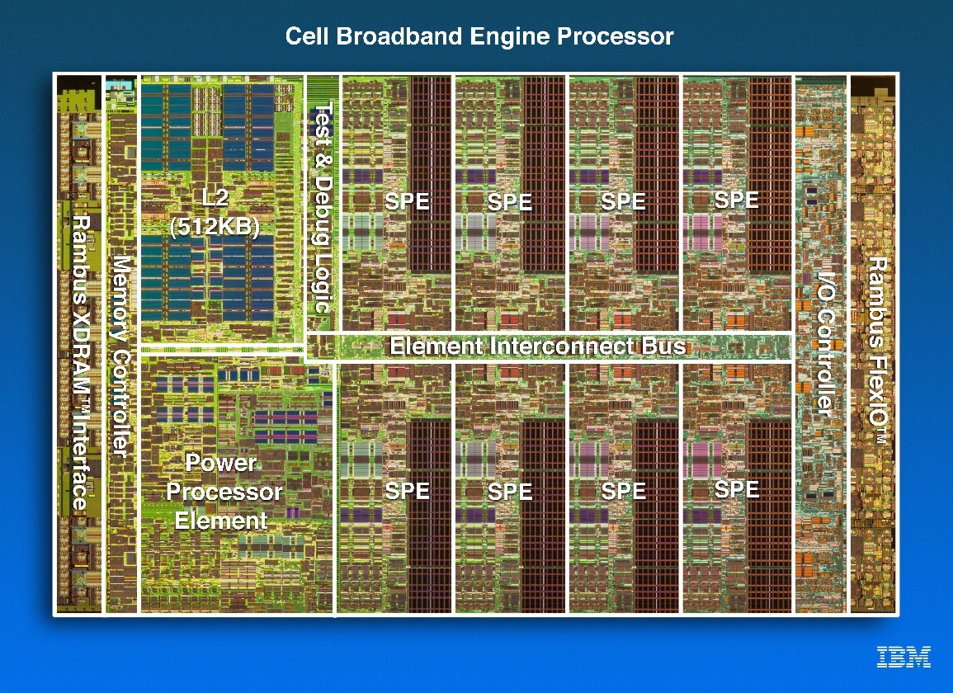
Cell Architecture: Layout

Slide 72
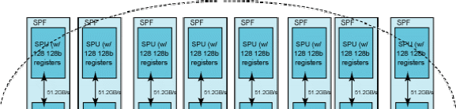
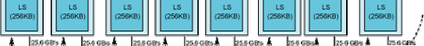
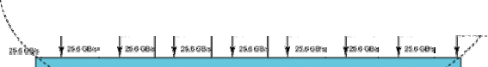
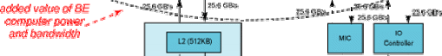
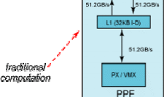
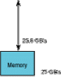
Cell Architecture

Slide 73
Memory & I/O
XDR RAMBUS is used as bus between EIB and main memory
2 x 32-bit channels, with 3.2Gbit/s data transfer per pin
25.6GB/s peak data transfer
potentially scalable to 6.4Gbit/s, offering a peak rate of 51.2GB/s
“FlexPhase” Technology
signals can arrive at different times, reducing need for exact wire length
Configurable to attach to variable amounts of main memory
Memory Interface Controller (MIC) controls the flow of data between the EIB and the XDR RAMBUS
RAMBUS RRAC FlexIO used for I/O
7 transmit, 5 receive 8-bit ports
35GB/s transmit peak
25GB/s receive peak
Used as a high speed interconnect between SPE's of different Cells when a multiple Cell architecture is in place
4 Cells can be seamlessly connected given the current architecture, an additional 4 with an added switch

Slide 74

Compiler
Octopiler
“single source” parallelizing, simdizing compiler
generates multiple binaries targeting both the PPE and SPE elements from one single source file
allows programmers to develop applications for parallel architectures with the illusion of a single shared memory image
Compiler-controlled software-cache, memory hierarchy optimizations, and code partitioning techniques assume all data resides in a shared system memory
enables automatic transfer of data and code
preserves coherence across all local SPE memories and system memory

Slide 75
Cell Programming Models
In order to obtain optimum performance within the Cell both the SPE's LS and Cell's SIMD dataflow must be taken into account by the programmer, and ultimately the programming model
Function Offload Model
SPE's used as accelerators for critical functions designated by the PPE
original code optimized and recompiled for SPE instruction set
designated program functions offloaded to SPE's for execution
when PPE calls designated program function it is automatically invoked on the SPE
Programmer statically identifies which program functions will execute on PPE and which will be offloaded to the SPE
separate source files and compilation for PPE and SPE
Prototype single-source approach using compiler directives as special offload hints has been developed for the Cell
challenge to have compiler automatically determine which functions execute
on PPE and SPE
allows applications to remain compatible with the Power Architecture generating both PPE and SPE binaries
Cell systems load SPE-accelerated binaries
Non-Cell systems load PPE binaries

Slide 76
Cell Programming Models
Device Extension Model
Special type of function offload model
SPE's act as interfaces between PPE and external devices
Use memory-mapped SPE-accessible registers as command/response FIFO between PPE and SPE's
Device memory can be mapped by DMA, supporting transfer size granularity as small as a single byte
Computational Acceleration Model
SPE centralized model, offering greater integration of SPE's in application execution and programming than function offload model
Computational intensive code performed on SPE's rather than PPE
PPE acts as a control center and service engine for the SPE software
Work is partitioned among multiple SPE's operating in parallel
manually done by programmers or automatically by compiler
must include efficient scheduling of DMA operations for code and data transfers between PPE and SPE
utilize shared-memory programming model or a supported message passing model
Generally provides extensive acceleration of intense math functions without requiring significant re-write or re-compilation

Slide 77
Cell Programming Models
Streaming Model
Designed to take advantage of support for message passing between PPE and SPE's
Construct serial or parallel pipelines using the SPE's
Each SPE applies a particular application kernel to the received data stream
PPE acts as a stream controller, with SPE's acting as data stream processors
Extremely efficient when each SPE performs an equivalent amount of work
Shared Memory Multiprocessor Model
Utilizes the two different instruction sets of the PPE and SPE to execute applications
provides great benefits to performance when utilizing just a single instruction set for a program would be very inefficient
Since DMA operations are cache coherent, combining DMA commands with SPE load/store commands provides the illusion of a single shared address space
conventional shared-memory loads are replaced by a DMA from system memory to an SPE's LS, and then a load from the LS to the SPE's register file
conventional shared-memory stores are replaced by a store from an SPE's register file to it's LS, then a DMA from the SPE's LS to system memory
Affective addresses in common with both PPE and SPE are used for all “pseudo”
shared-memory load/store commands
Possibilities exist for a compiler or interpretor to manage all SPE LS's as local caches for instruction and data

Slide 78
Cell Programming Models
Asymmetric Thread Runtime Model
Using this model the scheduling of threads on both the PPE and SPE are possible
Interaction among threads as in a conventional SMP
Similar to thread or lightweight task models of conventional operating systems
extensions exist to include processing units with different instruction sets as exists within the PPE and SPE's
Tasks are scheduled on both the PPE and SPE in order to optimize
performance and utilization of resources
abilities of the SPE to run only a single thread is thus hidden from programmer

Slide 79

Applications
Games (PS3)
Audio
Video
physics

Slide 80
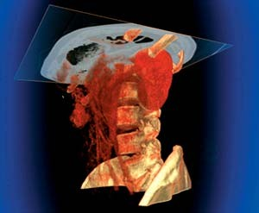
Applications
Imaging
Medical, rendering, feature extraction
Mercury – Blade, Turismo
Televisions (Toshiba)
MPEG decode

Slide 81
Nvidia Tesla GPU

Slide 82
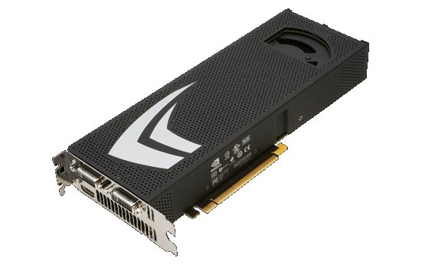
Intoduction
GPU: Graphics Processing Unit
Hundreds of Cores
Programmable
Can be easily installed in most desktops
Similar price to CPU
GPU follows Moore's Law better than CPU

Slide 83
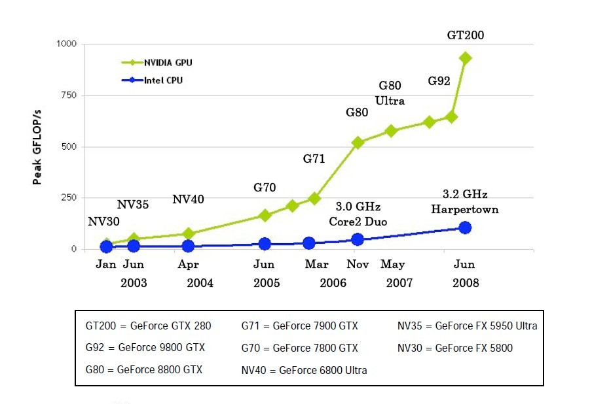
Introduction
Motivation:

Slide 84
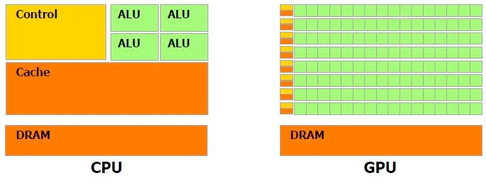
GPU Hardware
Multiprocessor Structure:

Slide 85
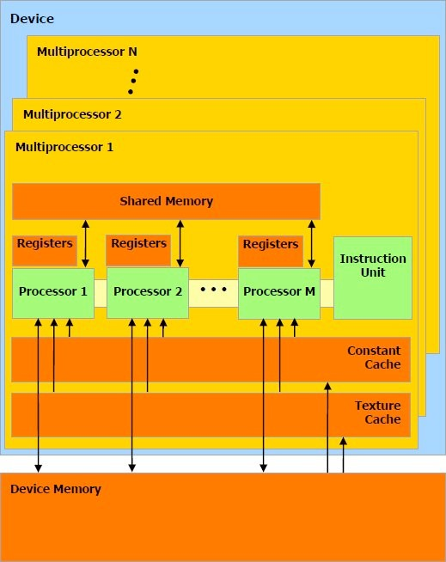
GPU Hardware
Multiprocessor Structure:
N multiprocessors with M cores each
SIMD – Cores share an Instruction Unit with other cores in a multiprocessor.
Diverging threads may not execute in parallel.

Slide 86
GPU Hardware
Memory Hierarchy:
Processors have 32-bit registers
Multiprocessors have shared memory, constant cache, and texture cache
Constant/texture cache are read- only and have faster access than shared memory.

Slide 87
Programming Model
Past:
The GPU was intended for graphics only, not general purpose computing.
The programmer needed to rewrite the program in a graphics language, such as OpenGL
Complicated
Present:
NVIDIA developed CUDA, a language for general purpose GPU computing
Simple

Slide 88
Programming Model
CUDA:
Compute Unified Device Architecture
Extension of the C language
Used to control the device
The programmer specifies CPU and GPU functions
The host code can be C++
Device code may only be C
The programmer specifies thread layout

Slide 89
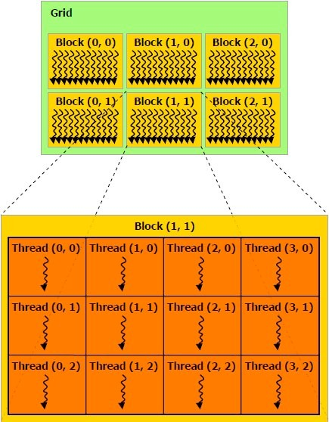
Programming Model
Thread Layout:
Threads are organized into
blocks.
Blocks are organized into a grid.
A multiprocessor executes one block at a time.
A warp is the set of threads executed in parallel
32 threads in a warp

Slide 90
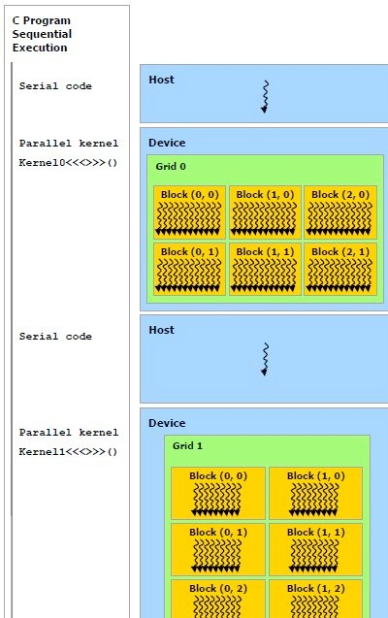
Programming Model
19
Heterogeneous Computing:
GPU and CPU execute different types of code.
CPU runs the main program, sending tasks to the GPU in the form of kernel functions
Multiple kernel functions may be declared and called.
Only one kernel may be called at a time.

Slide 91
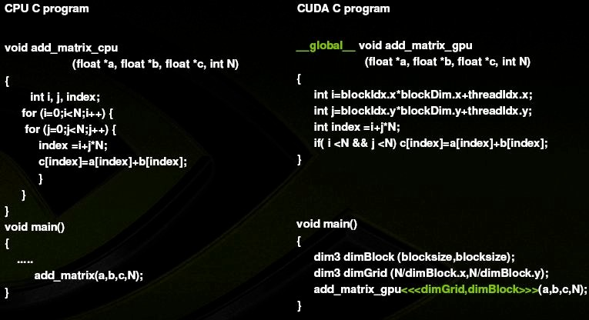
Programming Model: GPU vs. CPU Code

Slide 92
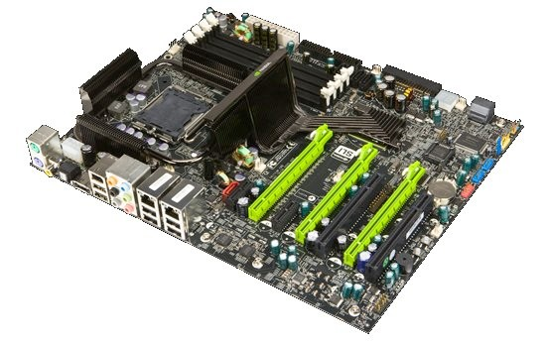
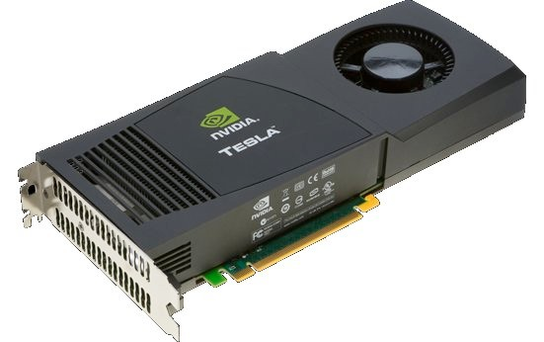
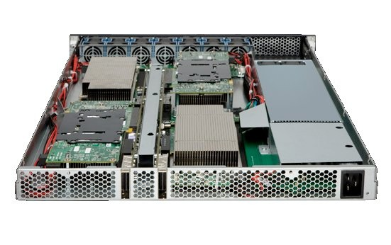
Supercomputing Products
Tesla C1060 GPU 933 GFLOPS
nForce Motherboard
Tesla C1070 Blade 4.14 TFLOPS

Slide 93
Intel Redefines GPU: Larrabee

Slide 94
Vision, Ambition, and Design Goals
Intel: Software is the New Hardware !
Intel: x86 ISA makes parallel program easier
Better flexibility and programmability
Support subroutine call and page faulting
Mostly software rendering pipeline, except texture filtering

Slide 95
Architecture Overview
Lots of x86 cores (8 to 64?)
Fully coherence L2 cache
Fully Programmable Rendering Pipeline
Shared L2, Divided L2
Cache Control Instructions
Ring Network
4-Way MT

Slide 96
Comparison with other GPU
Larrabee will use the x86 instruction set with Larrabee-specific extensions
Larrabee will feature cache coherency across all its cores.
Larrabee will include very little specialized graphics hardware, instead performing tasks like z-buffering, clipping, and blending in software, using a tile-based rendering approach.
more flexible than current GPUs

Slide 97
Comparison with other CPU
Based on the much simpler Pentium P54C design.
Each Larrabee core contains a 512-bit vector processing unit, able to process 16 single precision floating point numbers at a time.
Larrabee includes one major fixed-function graphics hardware feature: texture sampling units.
Larrabee has a 1024-bit (512-bit each way) ring bus for communication between cores and to memory.
Larrabee includes explicit cache control instructions.
Each core supports 4-way simultaneous multithreading, with 4 copies of each processor register.

Slide 98
New ISA
512 bit vector types (8×64bit double, 16×32bit float, or 16×32bit integer)
Lots of 3-operand instructions, like a=a*b+c
Most combinations of +,-,*,/ are provided, that is, you can choose between a*b-c, c-a*b and so forth.
Some instructions have built-in constants: 1-a*b
Many instructions take a predicate mask, which allows to selectively work on just a part of the 16-wide vector primitive types
32bit integer multiplications which return the lower 32bit of the result
Bit helper functions (scan for bit, etc.)
Explicit cache control functions (load a line, evict a line, etc.)
Horizontal reduce functions: Add all elements inside a vector, multiply all, get the minimum, and logical reduction (or, and, etc.).

Slide 99
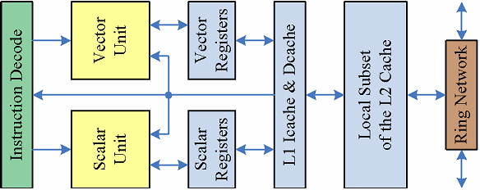
Overview
Scalar Processing Unit
Vector Processing Unit
Separated Register File
Communication via memory
Here is the block diagram of one Larrabee core. Basically, there are two Processing Unit in each cores: scalar processing unit and a vector processing unit. Although the two processing unit are located within the same core, they have completely separate register files. Moreover, there are not direct channel between scalar unit and vector unit, the nearest sharing module is L1 cache. That’s to say, the two units can not talk to each other unless using the system memory. The communication overhead maybe varied. If the shared memory is located in cache, the communication cost will be negligible.

Slide 100
Scalar Processing Unit
Derived from Pentium(1990s)
2-issue superscalar
In-order
Short, inexpensive pipeline execution
But more than that
64-bit
Enhanced multithreading – 4 threads per core
Aggressive pre-fetching
ISA extension, new cache features.
Notes:
The scalar unit is generally derived from an old Pentium core released early 1990s. It has 2-issue superscalar, in-order issue and short, inexpensive execution pipeline. However, it is not just a replicate of antique, instead it is far more than that. Larrabee’s scalar processing unit has 64bit support, and provides with an enhanced multithreading with up to 4 threads per core. Remember that the most latest Intel cores only support 2 threads per core with hyperthreading technique. Beyond those advanced features, Larrabee also employ an aggressive pre-fetching to increase the ILPs.

Slide 101
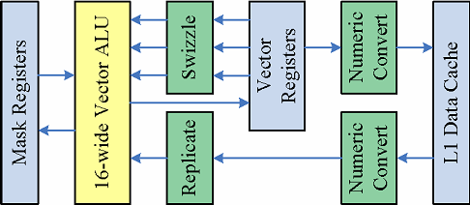
Vector Unit(VPU)
16-wide SIMD, each with 32bits wide data.
Load/stores with gather/scatter support.
Mask register enables flexible read and store within packed vector.

Slide 102
Cache Organization
L1
8K I-Cache and 8k D-Cache per thread
32K I/D cache per core
2-way
Treated as extended registers
L2
Coherent
Shared & Divided
A 256K subset for each core

Slide 103
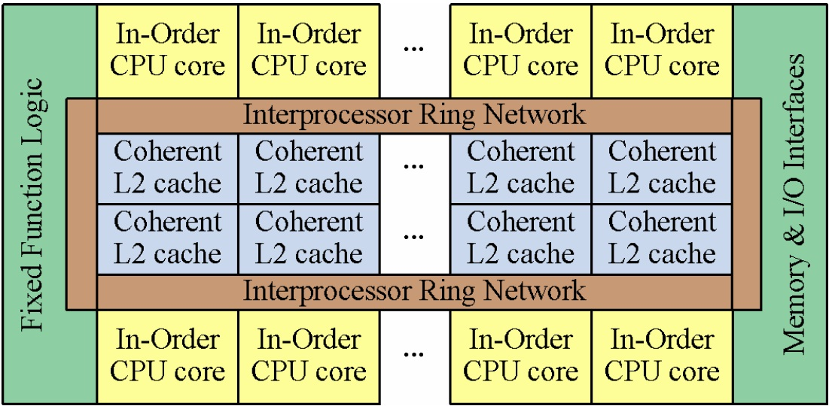
On Chip Network: Ring
Reason for doing this:
Simplify the design;
Cut costs;
Get to the market faster

Slide 104
Multithreading at Multiple Levels
Threads (Hyper-Threading)
Hardware-managed
As heavy as an application program or OS
Up to 4 threads per core
Fibers
Software-managed
Chunks decomposed by compliers
Typically up to 8 fibers per thread

Slide 105
Multithreading at Multiple Levels
Strands
Lowers level
Individual operations in the SIMD engines
One strand corresponds to a thread on GPUs
16 Strands because the 16-lane VPU

Slide 106
Larrabee Programming Model
“FULLY” programmable
Legacy code easy to migrate and deploy
Run both DirectX/OpenGL and C/C++ code.
Many C/C++ source can be recompiled without modification, due to x86 structures.
Crucial to large x86 legacy programs.
Limitations
System call
Requires application recompilation

Slide 107
Software Threading
Architecture level threading:
P-threads
Extended P-threads to support developers to specify thread affinity.
Better task scheduling (task stealing by Bluemofe,1996 & Reinders 2007), lower costs for threads creation and switching
Also supports OpenMP

Slide 108
Communication
Larrabe native binaries tightly bond with host binaries.
Larrabe library handles all memory message/data passing.
System calls like I/O functions are proxied from the Larrabe app back to OS service.

Slide 109
High level programming
Larrabe Native is also designed to implement some higher level programming languages.
Ct, Intel Math Kernel Library or Physics APIs.

Slide 110
Irregular Data Structure Support
Complex pointer trees, spatial data structures or large sparse n-dimensional matrices.
Developer-friendly: Larrabe allows but does not require direct software management to load data into memory.

Slide 111
Memory Hierarchy Difference with Nvidia GPUs
Nvidia Geforce
Memory sharing is supported by PBSM(Per-Block Shared Memories), 16KB on Geforce 8.
Each PBSM shared by 8 scalar processors.
Programmers MUST explicitly load data into PBSM.
Not directly sharable by different SIMD groups.
Larrabe
All memory shared by all processors.
Local data structure sharing transparantly provided by coherent cached memory hierarchy.
Don’t have to care about data loading procedure.
Scatter-gather mechanism

Slide 112

Intel® Nehalem
Micro-Architecture

Slide 113
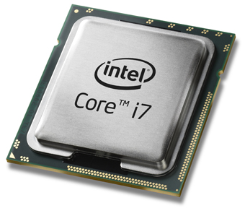
Outline
Brief History
Overview
Memory System
Core Architecture
Hyper- Threading Technology
Quick Path Interconnect (QPI)

Slide 114
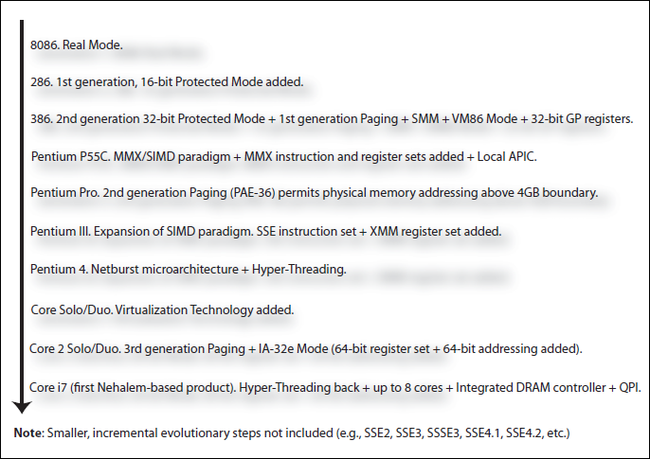
Brief History about Intel Processors

Slide 115
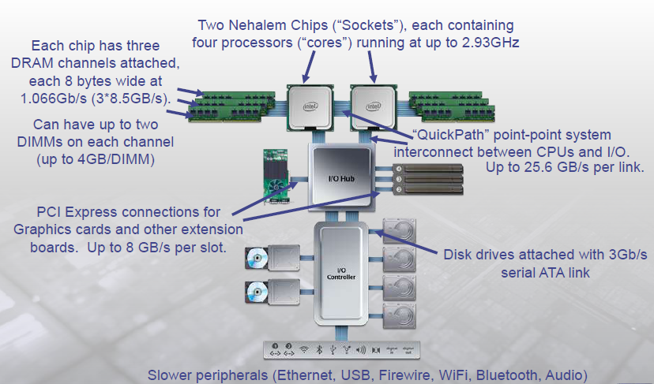
Nehalem System Example:

Slide 116
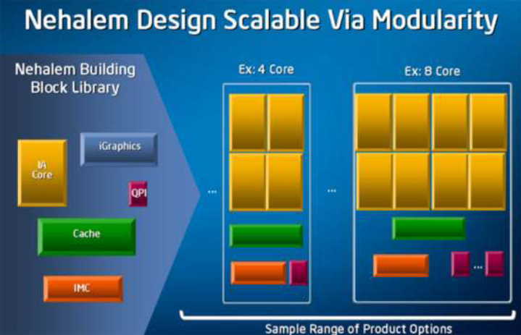
Building Blocks

Slide 117
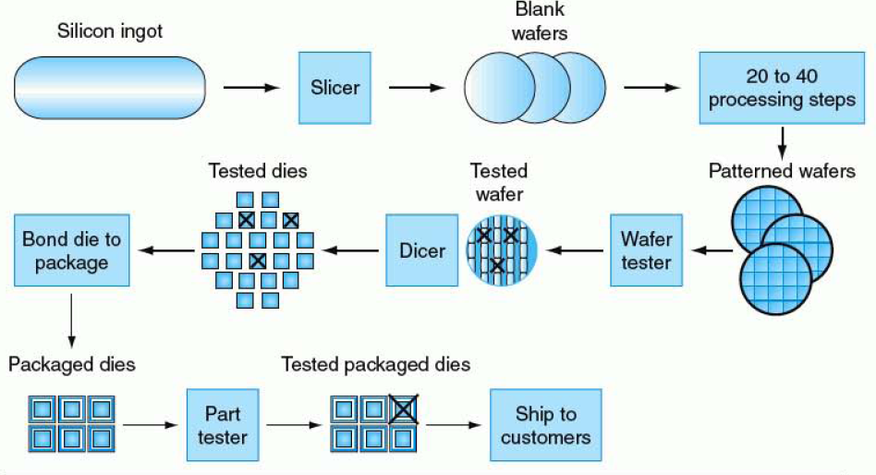
How to make Silicon Die?

Slide 118
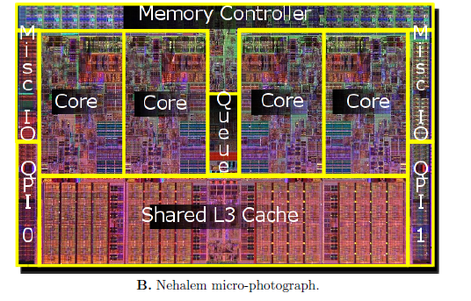
Overview of Nehalem Processor Chip
Four identical compute core
UIU: Un-core interface unit
L3 cache memory
and
data block memory

Slide 119
Overview of Nehalem Processor Chip(cont.)
IMC : Integrated Memory Controller with 3 DDR3 memory channels
QPI : Quick Path Interconnect ports
Auxiliary circuitry for
cache-coherence,
power control,
system management,
performance monitoring

Slide 120
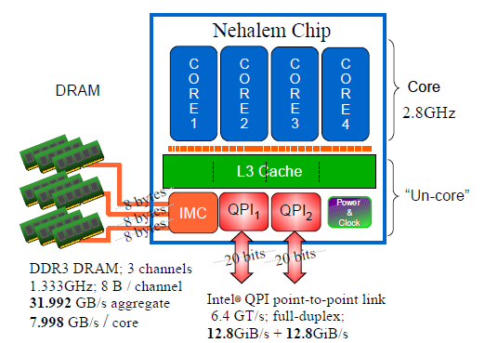
Overview of Nehalem Processor Chip(cont.)
Chip is divided into two domains:
“Un-core” and “core”
“Core” components operate with a
same clock frequency of the actual Core
“Un-Core” components operate
with different frequency.

Slide 121

Memory System and Core Architecture

Slide 122
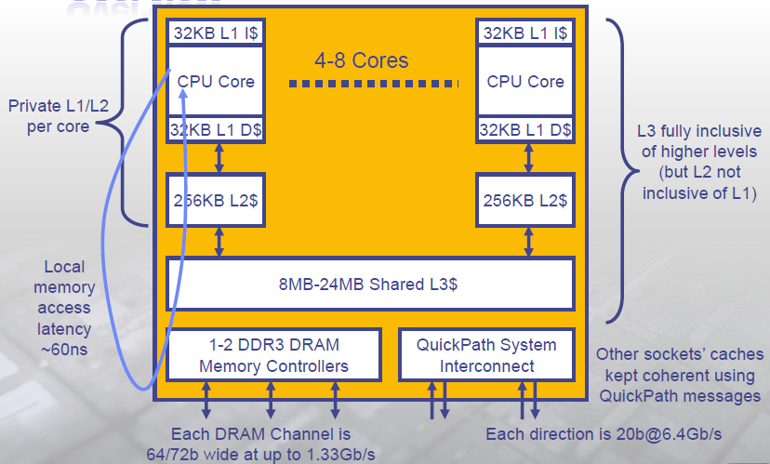
Nehalem Memory Hierarchy Overview

Slide 123
Cache Hierarchy Latencies
L1 32KB 8-way, Latency 4 cycles
L2 256KB 8-way, Latency < 12 cycles
L3 8MB shared , 16-way, Latency 30-40 cycles (4 core system)
L3 24MB shared, 24-way, Latency 30-60 cycles(8 core system)
DRAM , Latency ~ 180 – 200 cycles

Slide 124
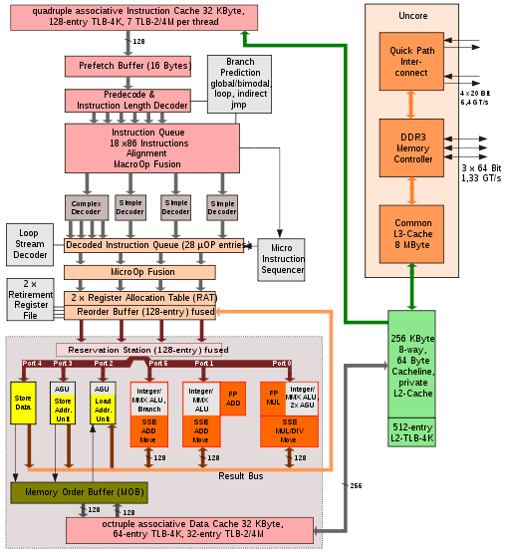
Nehalem Microarchitecture

Slide 125
Instruction Execution

Slide 126
Instruction Execution (1/5)
Instructions fetched from L2 cache

Slide 127
Instruction Execution (2/5)
Instructions fetched from L2 cache
Instructions decoded, prefetched and queued

Slide 128
Instruction Execution (3/5)
Instructions fetched from L2 cache
Instructions decoded, prefetched and queued
Instructions optimized and combined

Slide 129
Instruction Execution (4/5)
Instructions fetched from L2 cache
Instructions decoded, prefetched and queued
Instructions optimized and combined
Instructions executed

Slide 130
Instruction Execution (5/5)
Instructions fetched from L2 cache
Instructions decoded, prefetched and queued
Instructions optimized and combined
Instructions executed
Results written

Slide 131
Caches and Memory

Slide 132
Caches and Memory (1/5)
4-way set associative instruction cache

Slide 133
Caches and Memory (2/5)
4-way set associative instruction cache
8-way set associative L1 data cache (32 KB)

Slide 134
Caches and Memory (3/5)
4-way set associative instruction cache
8-way set associative L1 data cache (32 KB)
8-way set associative L2 data cache (256 KB)

Slide 135
Caches and Memory (4/5)
4-way set associative instruction cache
8-way set associative L1 data cache (32 KB)
8-way set associative L2 data cache (256 KB)
16-way shared L3 cache (8 MB)

Slide 136
Caches and Memory (5/5)
4-way set associative instruction cache
8-way set associative L1 data cache (32 KB)
8-way set associative L2 data cache (256 KB)
16-way shared L3 cache (8 MB)
3 DDR3 memory connections

Slide 137
Components
Instructions fetched from L2 cache
Instructions decoded, prefetched and queued
Instructions optimized and combined
Instructions executed
Results written

Slide 138
Components: Fetch
Instructions fetched from L2 cache
32 KB instruction cache
2-level TLB
L1
Instructions: 7-128 entries
Data: 32-64 entries
L2
512 data or instruction entries
Shared between SMT threads

Slide 139
Components: Decode
Instructions decoded, prefetched and queued
16 byte prefetch buffer
18-op instruction queue
MacroOp fusion
Combine small instructions into larger ones
Enhanced branch prediction

Slide 140
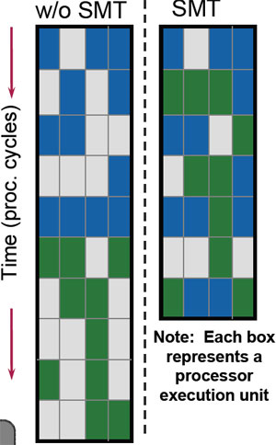
Components: Optimization
Instructions optimized and combined
4 op decoders
Enables multiple instructions per cycle
28 MicroOp queue
Pre-fusion buffer
MicroOp fusion
Create 1 “instruction” from MicroOps
Reorder buffer
Post-fusion buffer

Slide 141
Components: Execution
Instructions executed
4 FPUs
MUL, DIV, STOR, LD
3 ALUs
2 AGUs
Address generation
3 SSE Units
Supports SSE4
6 ports connecting the units

Slide 142
Components: Write-Back
Results written
Private L1/L2 cache

Slide 143
Components: Write-Back
Results written
Private L1/L2 cache
Shared L3 cache
QuickPath
Dedicated channel to another CPU, chip, or device
Replaces FSB

Slide 144
End of Unit 2

